Slide 1

Matchup: AB de Villiers vs Bumrah

Slide 2
Conclusion:
Balls Faced | 79
Runs Scored | 114
Outs | 2
Strike Rate | 144.00

Slide 3
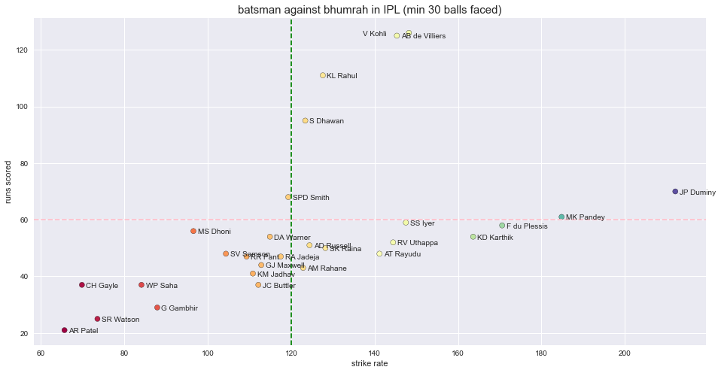
Conclusion:

Slide 4
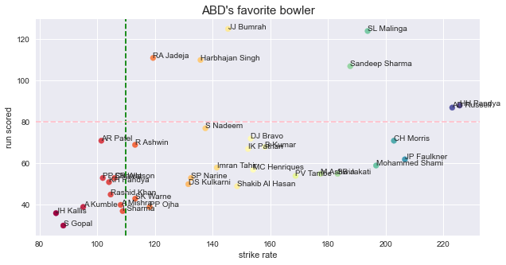
Conclusion:
ABD has 140+ strike rate against Bumrah. And he scored more than 120 runs.

Slide 5
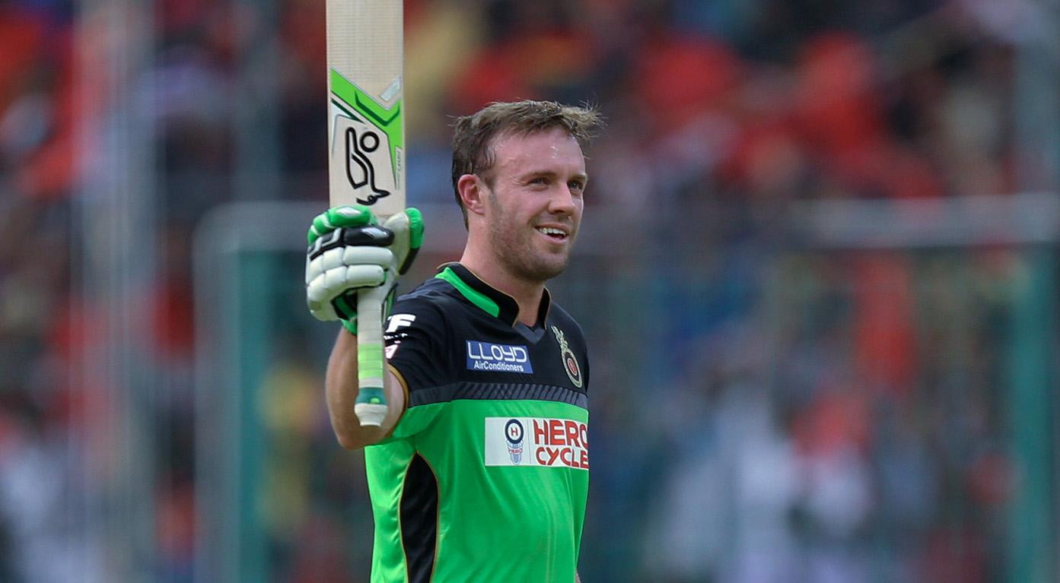
Clearly ABD wins the battle against Bumrah !!

